Slide 1
CS 107: Computer Architecture and Organization
SBCC
Spring 2020

Slide 2
System and clock control
The system control block includes several system features and control registers for a number of functions that are not related to specific peripheral devices. These include:
Chip Reset
Brown-Out Detection
Power control
Oscillators
PLLs
Clock selection and dividers
Chapter 3 of UM10562.pdf - LPC408x/407x User manual.

Slide 3
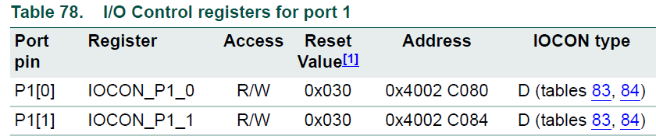
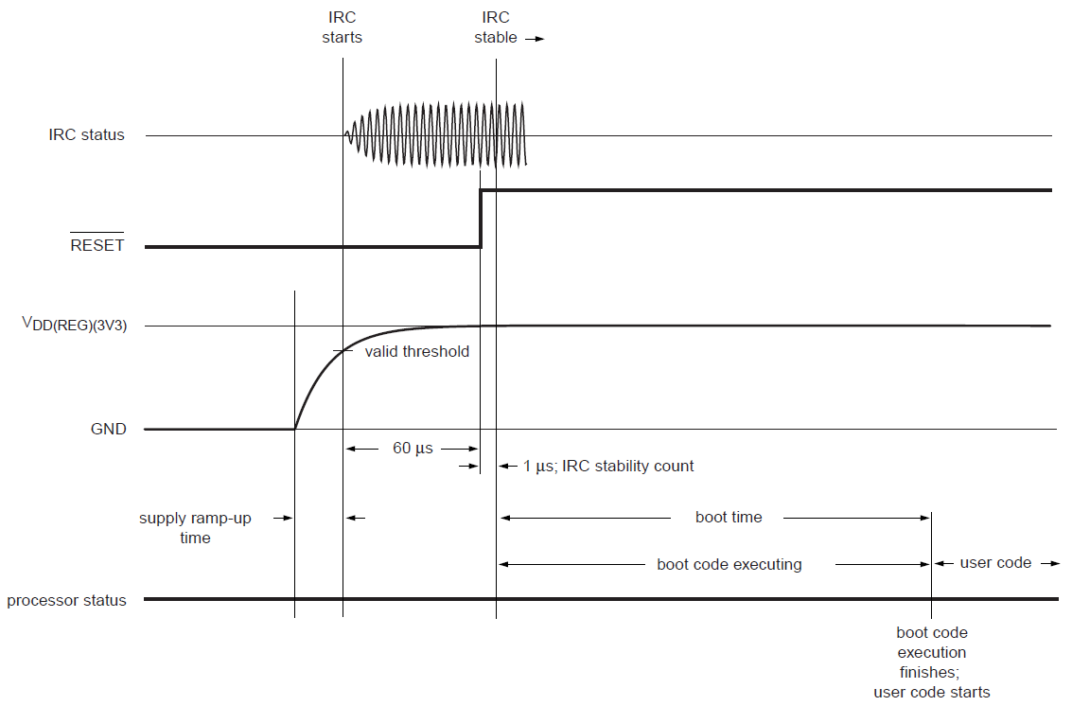
System and clock control
Chip Reset
Power On Reset (POR)
RESET pin
Watchdog Timer (WDT)
Brown Out Detect (BOD)
3
2
3
5
SP = [0x00000000]
PC = [0x00000004]
1
4
5

Slide 4



System and clock control
Watchdog Timer (WDT)
?

Slide 5
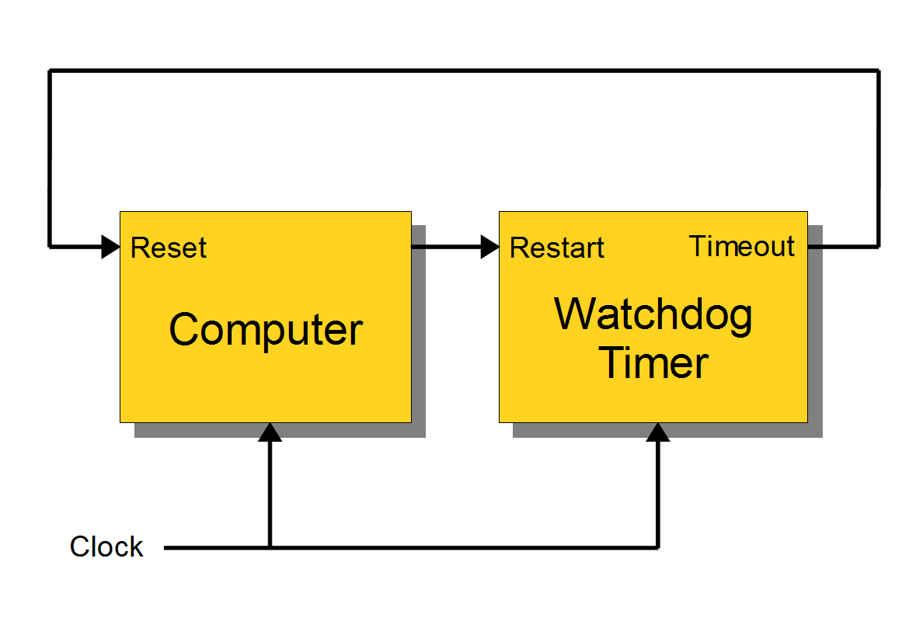
System and clock control
Watchdog Timer (WDT)
A watchdog timer (sometimes called a computer operating properly or COP timer, or simply a watchdog) is an electronic timer that is used to detect and recover from computer malfunctions. During normal operation, the computer regularly resets the watchdog timer to prevent it from elapsing, or "timing out". If, due to a hardware fault or program error, the computer fails to reset the watchdog, the timer will elapse and generate a timeout signal. The timeout signal is used to initiate corrective action or actions. The corrective actions typically include placing the computer system in a safe state and restoring normal system operation.
Chapter 31 of UM10562.pdf - LPC408x/407x User manual.

Slide 6
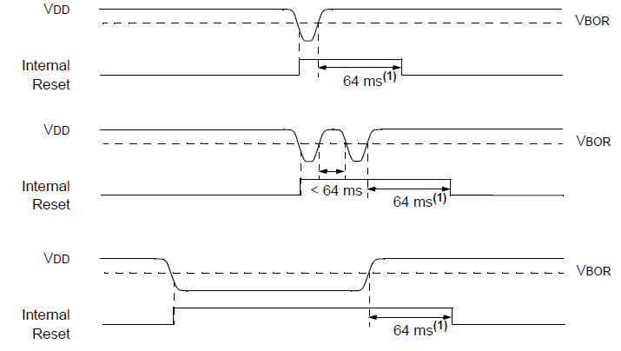
System and clock control
A brownout reset (BOR) is a circuit that causes a computer processor to reset (or reboot) in the event of a brownout, which is a significant drop in the power supply output voltage.

Slide 7

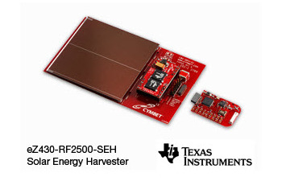
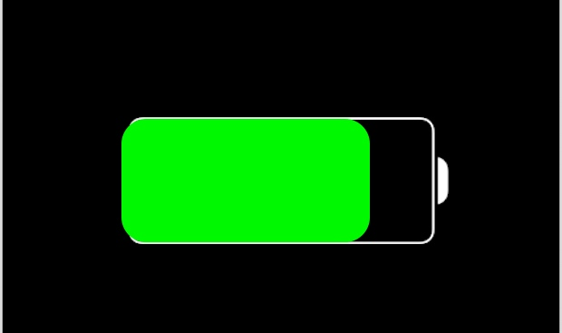
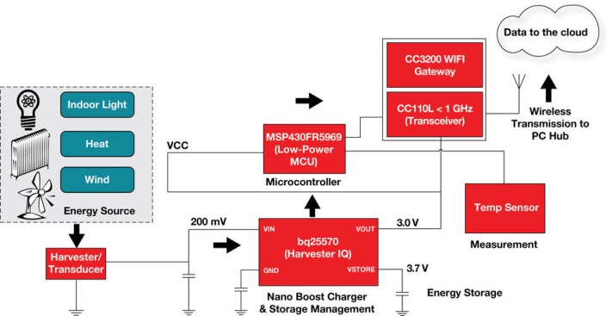

System and clock control
Power Control

Slide 8
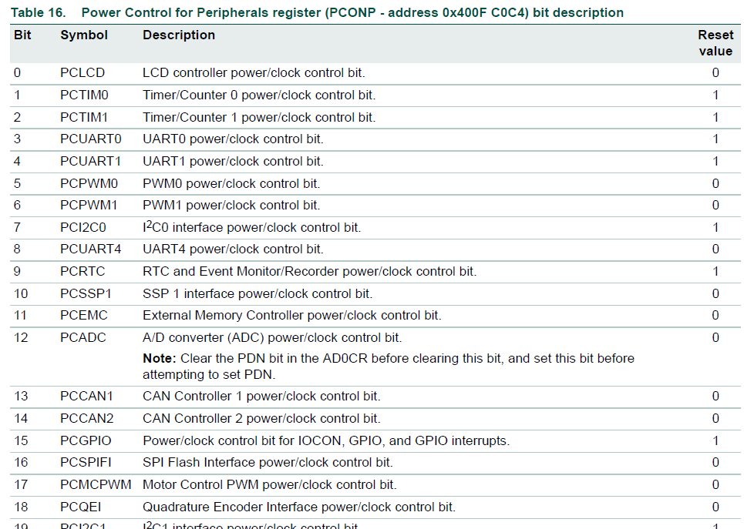
System and clock control
Power Control
ADC
3.3.2.2 Power Control for Peripherals register.
UM10562.pdf - LPC408x/407x User manual. Page 29
PCONP – address 0x400FC0C4
CPU
LCD
Ethernet
+
CMP
-

Slide 9
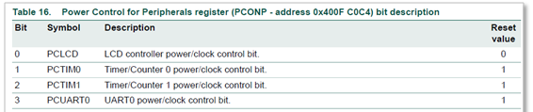
System and clock control
Power Control
Using GET BOARD.S
SYSCTLDEF.S
; ---------- Absolute addresses ------------
...
SYSR_PCONP EQU 0x400FC0C4
...
; ---------- Base/Offset addresses ---------
SYSTEM_CTRL_BASE EQU 0x400FC000
...
PCONP EQU 0x0C4
...
PCONP_PCLCD EQU 0x00000001
PCONP_PCTIM0 EQU 0x00000002
PCONP_PCTIM1 EQU 0x00000004
PCONP_PCUART0 EQU 0x00000008
PCONP_PCUART1 EQU 0x00000010
PCONP_PCPWM0 EQU 0x00000020
PCONP_PCPWM1 EQU 0x00000040
PCONP_PCI2C0 EQU 0x00000080
PCONP_PCUART4 EQU 0x00000100
PCONP_PCRTC EQU 0x00000200
PCONP_PCSSP1 EQU 0x00000400
PCONP_PCEMC EQU 0x00000800
PCONP_PCADC EQU 0x00001000
PCONP_PCCAN1 EQU 0x00002000
PCONP_PCCAN2 EQU 0x00004000
PCONP_PCGPIO EQU 0x00008000
...
;
; Turn LCD On and PCTIM0, PCTIM1 Off
; ‘Absolute address’ and
; ‘Read-Modify-Write’ methods
;
GET BOARD.S
ON_MASK EQU (PCONP_PCLCD)
OFF_MASK EQU (PCONP_PCTIM0:OR:PCONP_PCTIM1)
. . .
LDR R1, =SYSR_PCONP
LDR R2, [R1] ; R2 = PCONP –- Read!
LDR R3, =ON_MASK
ORR R2, R3 ; Modify! Turn On...
LDR R3, =OFF_MASK
BIC R2, R3 ; Modify! Turn Off
STR R2, [R1] ; PCONP = R2 –- Write!
. . .

Slide 10
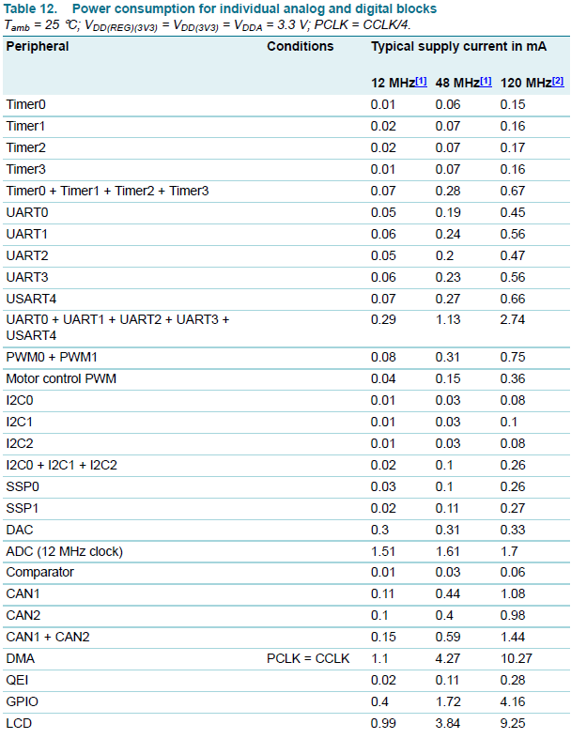
System and clock control
Power Control
Peripheral power consumption (LPC408X_7X_DS.pdf, Page 90)

Slide 11
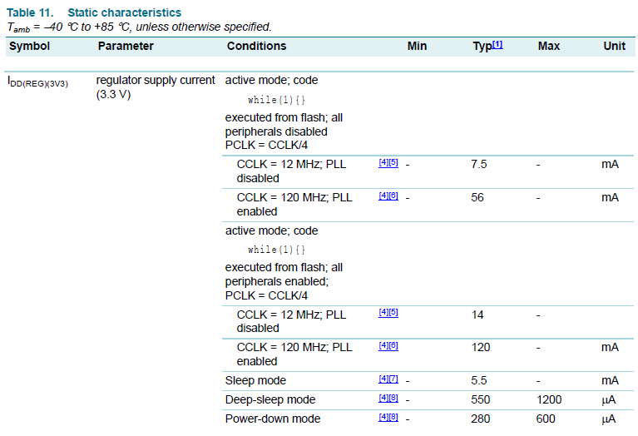
System and clock control
Power Control
Peripheral power consumption (LPC408X_7X_DS.pdf, Page 90)
Static characteristics (LPC408X_7X_DS.pdf, Page 85)

Slide 12
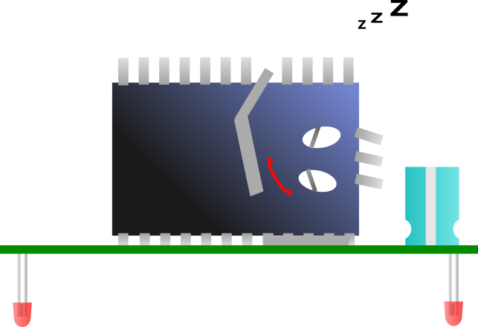


System and clock control
Power Control
Sleep Mode
 | CPU | Peripherals | Clocks | Flash | SRAM | Wake-up
Sleep | Stop | On | On | Standby | Standby | Fast
Deep Sleep | Standby | Off | IRC & RTC On | Standby | Standby | Medium
Power-down | Standby | Off | RTC On | Off | Standby | Long
Deep Power-down | Off | Off | RTC On | Off | Off | Very Long

Slide 13
System and clock control
Power Control
Sleep Mode
Static characteristics (LPC408X_7X_DS.pdf, Page 85)
 | CPU | Peripherals | Clocks | Flash | SRAM | Wake-up
Sleep | Stop | On | On | Standby | Standby | Fast
Deep Sleep | Standby | Off | IRC & RTC On | Standby | Standby | Medium
Power-down | Standby | Off | RTC On | Off | Standby | Long
Deep Power-down | Off | Off | RTC On | Off | Off | Very Long

Slide 14

System and clock control
Power Control
IR
MCU
1
2
3
4
5
6
7
8
9
Wakeup
Button
detection
Sending
command
0
^
^
Sleep
Power
v
v
Cycle power
Sleep power
time

Slide 15
System and clock control
Power Control
Peripheral power consumption (LPC408X_7X_DS.pdf, Page 90)
Static characteristics (LPC408X_7X_DS.pdf, Page 85)

Slide 16
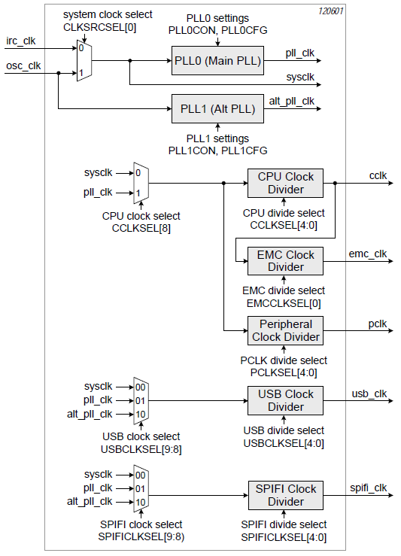
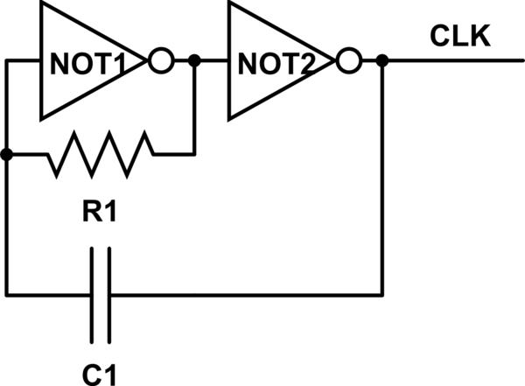
System and clock control
Clock Generation
IRC – Internal RC Oscillator
12 MHz +/- 1%

Slide 17
System and clock control
Clock Generation
IRC – Internal RC Oscillator
12 MHz
12 MHz +/- 1%
12 MHz / 4 = 3 MHz

Slide 18
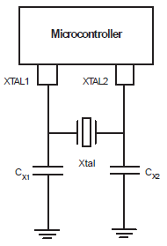
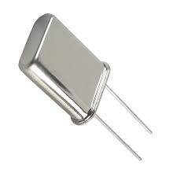
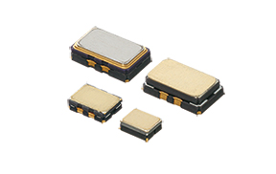
System and clock control
Clock Generation
OSC_CLK – Main Oscillator
1 MHz .. 25 MHz
12 MHz +/- 0.002.. 0.005 %
12 MHz +/- 1%

Slide 19
System and clock control
Clock Generation
OSC_CLK – Main Oscillator
SCS
12 MHz
12 MHz / 4 = 3 MHz
1 MHz .. 25 MHz
12 MHz +/- 0.002.. 0.005 %
12 MHz +/- 1%

Slide 20
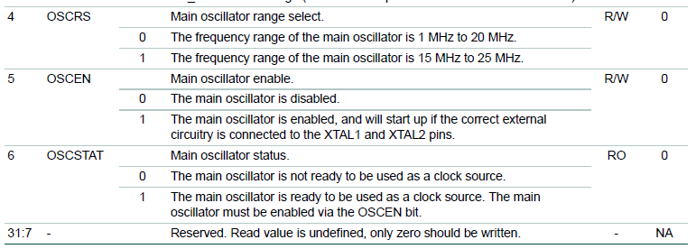
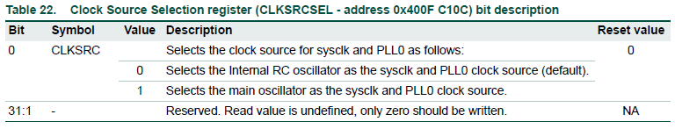
System and clock control
Clock Generation
Bits 0..3 – Ext. memory and SD-card power control (better not to change it)

Slide 21
System and clock control
Clock Generation
Bits 0..3 – Ext. memory and SD-card power control (better not to change it)
To switch the CPU to OSC Clock:
Set SCS.OSCEN bit to ‘1’
Wait for ‘1’ in SCS.OSCSTAT bit
Set CLKSRCSEL.CLKSRC bit to ‘1’

Slide 22
System and clock control
Clock Generation
Using GET BOARD.S
SYSCTLDEF.S
; ---------- Absolute addresses ------------
SYSR_SCS EQU 0x400FC1A0
...
SYSR_CLKSRCSEL EQU 0x400FC10C
...
; ---------- Base/Offset addresses ---------
SYSTEM_CTRL_BASE EQU 0x400FC000
...
CLKSRCSEL EQU 0x10C
...
SCS EQU 0x1A0
...
SCS_OSCRS EQU 0x10
SCS_OSCEN EQU 0x20
SCS_OSCSTAT EQU 0x40
...
CLKSRCSEL_CLKSRC EQU 1
...
;
; Switching the CPU to OSC Clock
; ‘Base-offset’ method
;
GET BOARD.S
;
; Set SCS.OSCEN bit to ‘1’
; ‘Read-Modify-Write’ method
;
LDR R1, =SYSTEM_CTRL_BASE
LDR R2, [R1, #SCS] ; R2 = SCS –- Read!
ORR R2, #SCS_OSCEN ; Modify! Set bit...
STR R2, [R1, #SCS] ; SCS = R2 –- Write!
;
; Wait for ‘1’ in SCS.OSCSTAT bit
; ‘do .. while’ loop
;
wait_for_osc_ready
LDR R2, [R1, #SCS] ; R2 = SCS
TST R2, #SCS_OSCSTAT ; Check OSCSTAT bit
BEQ wait_for_osc_ready ; repeat if still 0
;
; Set CLKSRCSEL.CLKSRC bit to ‘1’
; ‘Write all at once’ method
;
MOV R2, #CLKSRCSEL_CLKSRC ; R2 = 1
STR R2, [R1, #CLKSRCSEL] ; CLKSRCSEL = R2

Slide 23
System and clock control
Clock Generation
Using GET BOARD.S
SYSCTLDEF.S
; ---------- Absolute addresses ------------
SYSR_SCS EQU 0x400FC1A0
...
SYSR_CLKSRCSEL EQU 0x400FC10C
...
; ---------- Base/Offset addresses ---------
SYSTEM_CTRL_BASE EQU 0x400FC000
...
CLKSRCSEL EQU 0x10C
...
SCS EQU 0x1A0
...
SCS_OSCRS EQU 0x10
SCS_OSCEN EQU 0x20
SCS_OSCSTAT EQU 0x40
...
CLKSRCSEL_CLKSRC EQU 1
...
;
; Switching the CPU to OSC Clock
; ‘Base-offset’ method
;
GET BOARD.S
;
; Set SCS.OSCEN bit to ‘1’
; ‘Read-Modify-Write’ method
;
LDR R1, =SYSTEM_CTRL_BASE
LDR R2, [R1, #SCS] ; R2 = SCS –- Read!
ORR R2, #SCS_OSCEN ; Modify! Set bit...
STR R2, [R1, #SCS] ; SCS = R2 –- Write!
;
; Wait for ‘1’ in SCS.OSCSTAT bit
; ‘do .. while’ loop
;
wait_for_osc_ready
LDR R2, [R1, #SCS] ; R2 = SCS
TST R2, #SCS_OSCSTAT ; Check OSCSTAT bit
BEQ wait_for_osc_ready ; repeat if still 0
;
; Set CLKSRCSEL.CLKSRC bit to ‘1’
; ‘Write all at once’ method
;
MOV R2, #CLKSRCSEL_CLKSRC ; R2 = 1
STR R2, [R1, #CLKSRCSEL] ; CLKSRCSEL = R2

Slide 24
System and clock control
Clock Generation
Using GET BOARD.S
SYSCTLDEF.S
;
; Switching the CPU to OSC Clock
; ‘Base-offset’ method
;
GET BOARD.S
;
; Set SCS.OSCEN bit to ‘1’
; ‘Read-Modify-Write’ method
;
LDR R1, =SYSTEM_CTRL_BASE
LDR R2, [R1, #SCS] ; R2 = SCS –- Read!
ORR R2, #SCS_OSCEN ; Modify! Set bit...
STR R2, [R1, #SCS] ; SCS = R2 –- Write!
;
; Wait for ‘1’ in SCS.OSCSTAT bit
; ‘do .. while’ loop
;
wait_for_osc_ready
LDR R2, [R1, #SCS] ; R2 = SCS
TST R2, #SCS_OSCSTAT ; Check OSCSTAT bit
BEQ wait_for_osc_ready ; repeat if still 0
;
; Set CLKSRCSEL.CLKSRC bit to ‘1’
; ‘Write all at once’ method
;
MOV R2, #CLKSRCSEL_CLKSRC ; R2 = 1
STR R2, [R1, #CLKSRCSEL] ; CLKSRCSEL = R2
0, 0, 0, 0, 0, 4, 4, 4, 4…
5
Bit2
wait_for_bit2
LDRH R2, [R1], #2 ; R2 = Mem[R1]
. . .
TST R2, #BIT2 ; Check Bit 2 for 1
BEQ wait_for_bit2 ; repeat if still 0
. . .

Slide 25
System and clock control
Clock Generation
Static characteristics (LPC408X_7X_DS.pdf, Page 85)

Slide 26
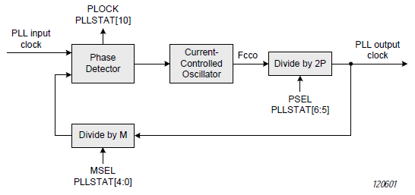
System and clock control
Clock Generation
PLL – Phase-locked loop
Input clock: 10..25 MHz, OSC only!
Fcco: 156 MHz to 320 MHz.
Output clock: 9.75..160 MHz.

Slide 27
System and clock control
Clock Generation
PLL – Phase-locked loop
Fref < Fin -> Go Up!
192 MHz
P = 1
Fin = 12 MHz
Fout = 96 MHz
Fref > Fin -> Go Down!
156 .. 320 MHz.
96 MHz
Fref = 12 MHz
PSEL = 1, 2, 4 or 8
M = 8

Slide 28
System and clock control
Clock Generation
PLL – Phase-locked loop
Fref < Fin -> Go Up!
192 MHz
P = 1
Fin = 12 MHz
Fout = 96 MHz
Fref > Fin -> Go Down!
156 .. 320 MHz.
96 MHz
Fref = 12 MHz
PSEL = 1, 2, 4 or 8
M = 8
M = Fout/Fin
P: Fout * 2P in 156..320 MHz

Slide 29
System and clock control
Clock Generation
PLL – Phase-locked loop
Fref < Fin -> Go Up!
192 MHz
P = 1
Fin = 12 MHz
Fout = 96 MHz
Fref > Fin -> Go Down!
156 .. 320 MHz.
96 MHz
Fref = 12 MHz
PSEL = 1, 2, 4 or 8
M = 8
Fout = 36 MHz. M = 36 / 12 = 3
P = 1? 36 * 2 = 72 MHz – Not Ok!
P = 2? 36 * 4 = 144 MHz – Not Ok!
P = 4? 36 * 8 = 288 MHz – Ok!
M = Fout/Fin
P: Fout * 2P in 156..320 MHz

Slide 30
System and clock control
Clock Generation
PLL – Phase-locked loop
12 MHz (0x00B71B00)
24 MHz (0x016E3600)
36 MHz (0x02255100)
48 MHz (0x02DC6C00)
.
.
.
120 MHz (0x07270E00)
Fref < Fin -> Go Up!
23 MHz, 25 MHz
32 MHz, 33 MHz, 37 MHz
192 MHz
P = 1
Fin = 12 MHz
Fout = 96 MHz
Fref > Fin -> Go Down!
156 .. 320 MHz.
96 MHz
…
M = CLK / 12000000
K = CLK % 12000000
If ((K <> 0) && (K > 6000000))
M = M + 1
…
Fref = 12 MHz
PSEL = 1, 2, 4 or 8
M = 8
Fout = 36 MHz. M = 36 / 12 = 3
P = 1? 36 * 2 = 72 MHz – Not Ok!
P = 2? 36 * 4 = 144 MHz – Not Ok!
P = 4? 36 * 8 = 288 MHz – Ok!
M = Fout/Fin
P: Fout * 2P in 156..320 MHz

Slide 31
System and clock control
Clock Generation
PLL – Phase-locked loop
SCS
36 MHz
36 MHz / 4
= 9 MHz

Slide 32
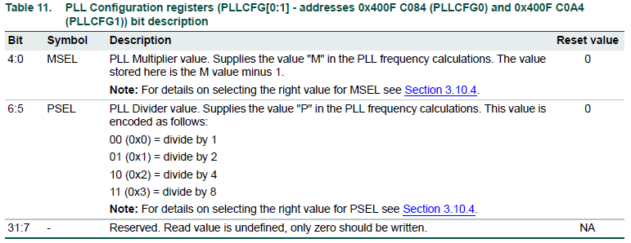
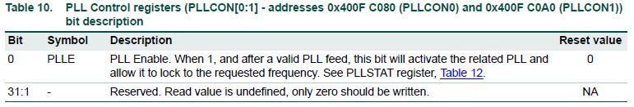
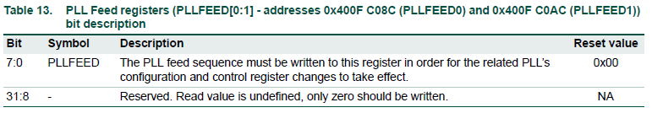
System and clock control
Clock Generation

Slide 33
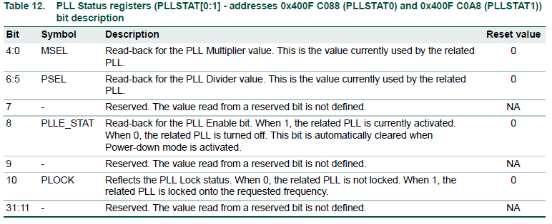
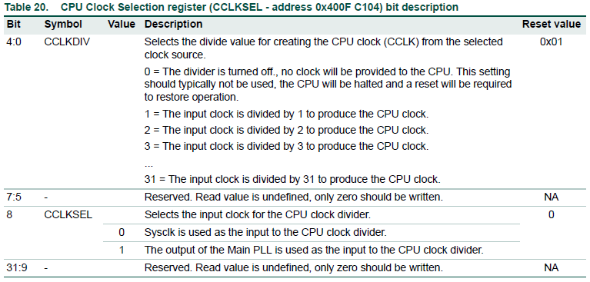
System and clock control
Clock Generation
Read-Modify-Write!

Slide 34
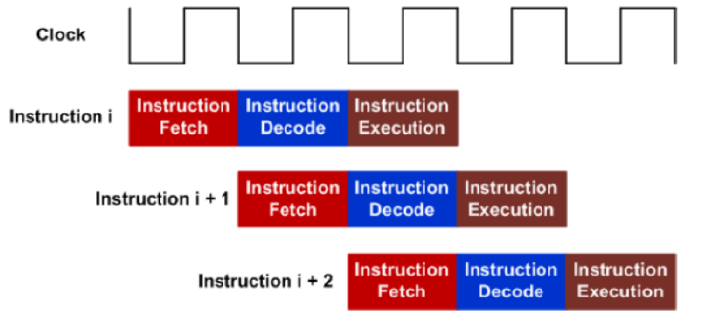

Instructions
Decode
Fetch
Execute
Pipelining allows hardware resources to be fully utilizing
One 32-bit instruction or two 16-bit instructions can be fetched

Slide 35
Instructions
Decode
Fetch
Execute
Pipelining allows hardware resources to be fully utilizing
One 32-bit instruction or two 16-bit instructions can be fetched

Slide 36
System and clock control
Clock Generation
PLL – Phase-locked loop
To switch the CPU to PLL Clock:
Run OSC and switch sysclk to OSC (done)
Write PSEL and MSEL into PLLCFG0
Set PLLCON0.PLLE bit to ‘1’
Write 0xAA into PLLFEED0
Write 0x55 into PLLFEED0
Wait for ‘1’ in PLLSTAT0.PLOCK bit
Set CCLKSEL.CCLKSEL bit to ‘1’
SCS
36 MHz
36 MHz / 4
= 9 MHz

Slide 37
System and clock control
Clock Generation
Using GET BOARD.S
SYSCTLDEF.S
; ---------- Base/Offset addresses ---------
SYSTEM_CTRL_BASE EQU 0x400FC000
PLLCON0 EQU 0x080
PLLCFG0 EQU 0x084
PLLSTAT0 EQU 0x088
PLLFEED0 EQU 0x08C
...
CCLKSEL EQU 0x104
...
CCLKSEL_DIV0 EQU 0
CCLKSEL_DIV1 EQU 1
CCLKSEL_DIV2 EQU 2
...
CCLKSEL_DIV32 EQU 31
CCLKSEL_CCLKSEL EQU 0x0100
PLLCON_PLLE EQU 1
PLLCFG_MSEL_1 EQU 0
PLLCFG_MSEL_2 EQU 1
PLLCFG_MSEL_3 EQU 2
...
PLLCFG_MSEL_32 EQU 31
PLLCFG_PSEL_1 EQU (0<<5)
PLLCFG_PSEL_2 EQU (1<<5)
PLLCFG_PSEL_4 EQU (2<<5)
PLLCFG_PSEL_8 EQU (3<<5)
PLLSTAT_PLLE_STAT EQU 0x100
PLLSTAT_PLOCK EQU 0x400
; Turning On PLL0
; ‘Base-offset’ method
;
GET BOARD.S
; Run OSC and switch sysclk to OSC
LDR R1, =SYSTEM_CTRL_BASE
...
; Write PSEL=4 and MSEL=3 into PLLCFG0
; ‘Write all at once’ method
LDR R2, =(PLLCFG_MSEL_3:OR:PLLCFG_PSEL_4)
STR R2, [R1, #PLLCFG0] ; PLLCFG0 = R2
; Set PLLCON0.PLLE bit to ‘1’
; ‘Write all at once’ method
MOV R2, #PLLCON_PLLE
STR R2, [R1, #PLLCON0] ; PLLCON0 = R2
; Write 0xAA and 0x55 into PLLFEED0
; ‘Write all at once’ method
MOV R2, #0xAA
STR R2, [R1, #PLLFEED0] ; PLLFEED0 = 0xAA
MOV R2, #0x55
STR R2, [R1, #PLLFEED0] ; PLLFEED0 = 0xAA;
; Wait for ‘1’ in PLLSTAT0.PLOCK
; ‘do .. while’ loop
wait_for_pll
LDR R2, [R1, #PLLSTAT0] ; R2 = PLLSTAT0
TST R2, #PLLSTAT_PLOCK ; Check PLOCK bit
BEQ wait_for_pll ; repeat if still 0
; Set CCLKSEL.CCLKSEL bit to ‘1’
; ‘Read-Modify-Write’ method
LDR R2, [R1, #CCLKSEL] ; R2 = CCLKSEL –- Read!
ORR R2, #CCLKSEL_CCLKSEL ; Modify! Set bit...
STR R2, [R1, #CCLKSEL] ; CCLKSEL = R2 –- Write!

Slide 38
System and clock control
Clock Generation
Using GET BOARD.S
SYSCTLDEF.S
; ---------- Base/Offset addresses ---------
SYSTEM_CTRL_BASE EQU 0x400FC000
PLLCON0 EQU 0x080
PLLCFG0 EQU 0x084
PLLSTAT0 EQU 0x088
PLLFEED0 EQU 0x08C
...
CCLKSEL EQU 0x104
...
CCLKSEL_DIV0 EQU 0
CCLKSEL_DIV1 EQU 1
CCLKSEL_DIV2 EQU 2
...
CCLKSEL_DIV32 EQU 31
CCLKSEL_CCLKSEL EQU 0x0100
PLLCON_PLLE EQU 1
PLLCFG_MSEL_1 EQU 0
PLLCFG_MSEL_2 EQU 1
PLLCFG_MSEL_3 EQU 2
...
PLLCFG_MSEL_32 EQU 31
PLLCFG_PSEL_1 EQU (0<<5)
PLLCFG_PSEL_2 EQU (1<<5)
PLLCFG_PSEL_4 EQU (2<<5)
PLLCFG_PSEL_8 EQU (3<<5)
PLLSTAT_PLLE_STAT EQU 0x100
PLLSTAT_PLOCK EQU 0x400
; Turning On PLL0
; ‘Base-offset’ method
;
GET BOARD.S
; Run OSC and switch sysclk to OSC
LDR R1, =SYSTEM_CTRL_BASE
...
; Write PSEL=4 and MSEL=3 into PLLCFG0
; ‘Write all at once’ method
LDR R2, =(PLLCFG_MSEL_3:OR:PLLCFG_PSEL_4)
STR R2, [R1, #PLLCFG0] ; PLLCFG0 = R2
; Set PLLCON0.PLLE bit to ‘1’
; ‘Write all at once’ method
MOV R2, #PLLCON_PLLE
STR R2, [R1, #PLLCON0] ; PLLCON0 = R2
; Write 0xAA and 0x55 into PLLFEED0
; ‘Write all at once’ method
MOV R2, #0xAA
STR R2, [R1, #PLLFEED0] ; PLLFEED0 = 0xAA
MOV R2, #0x55
STR R2, [R1, #PLLFEED0] ; PLLFEED0 = 0xAA;
; Wait for ‘1’ in PLLSTAT0.PLOCK
; ‘do .. while’ loop
wait_for_pll
LDR R2, [R1, #PLLSTAT0] ; R2 = PLLSTAT0
TST R2, #PLLSTAT_PLOCK ; Check PLOCK bit
BEQ wait_for_pll ; repeat if still 0
; Set CCLKSEL.CCLKSEL bit to ‘1’
; ‘Read-Modify-Write’ method
LDR R2, [R1, #CCLKSEL] ; R2 = CCLKSEL –- Read!
ORR R2, #CCLKSEL_CCLKSEL ; Modify! Set bit...
STR R2, [R1, #CCLKSEL] ; CCLKSEL = R2 –- Write!

Slide 39
System and clock control
LAB 7
Clock Control
(Simulator!)

